Slide 1
<TITLE>
<NAME>
Advisor
Dr. Anamika Dubey
Date : < >
Department of Electrical Engineering and Computer Science
Pullman, Washington

Slide 2
Outline <feel free to modify the contents>
introduction
literature review
motivation and objective
model description
results and analysis
conclusion
<references>
(this should be optional if you include the references on the bottom of respective slides)

Slide 3
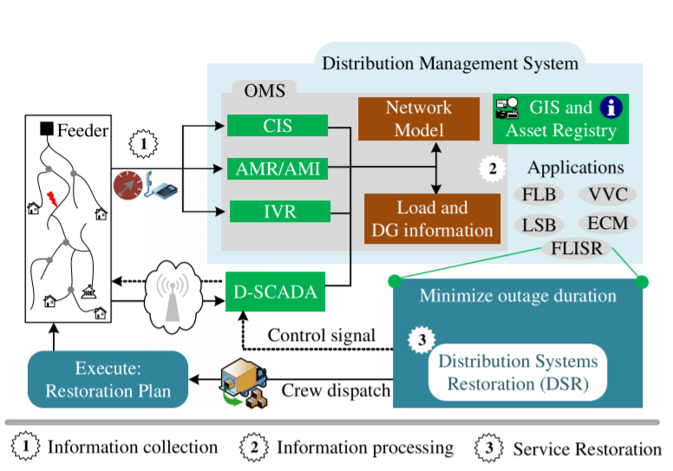
Introduction (sample slide)
power distribution system resilient restoration
the end users and customers are a part of power distribution system
some critical loads need to be restored earlier than the others (hospitals, wastewater plants etc.) [1]
the protocols work under distribution management system (DMS)
information collection
information processing
service restoration
[1] S. Poudel, A. Dubey and K. P. Schneider, "A Generalized Framework for Service Restoration in a Resilient Power Distribution System," in IEEE Systems Journal, doi: 10.1109/JSYST.2020.3011901.

Slide 4
Literature Review

Slide 5
Motivation and Objective

Slide 6
Hurricane Models

Slide 7
Results
<be specific with the titles>
<slide titles do not have to be the same as the outline>
<the outline would just be a big picture of your content>

Slide 8
Conclusion

